Slide 1
Data Warehouse ——What is a Data Warehouse?——
徐华
清华大学 计算机系 智能技术与系统国家重点实验室
xuhua@tsinghua.edu.cn

Slide 2
Data Warehouse
Review the basic concepts of database
What is a data warehouse?
A multi-dimensional data model
Data warehouse architecture
Data warehouse implementation
From data warehousing to data mining

Slide 3
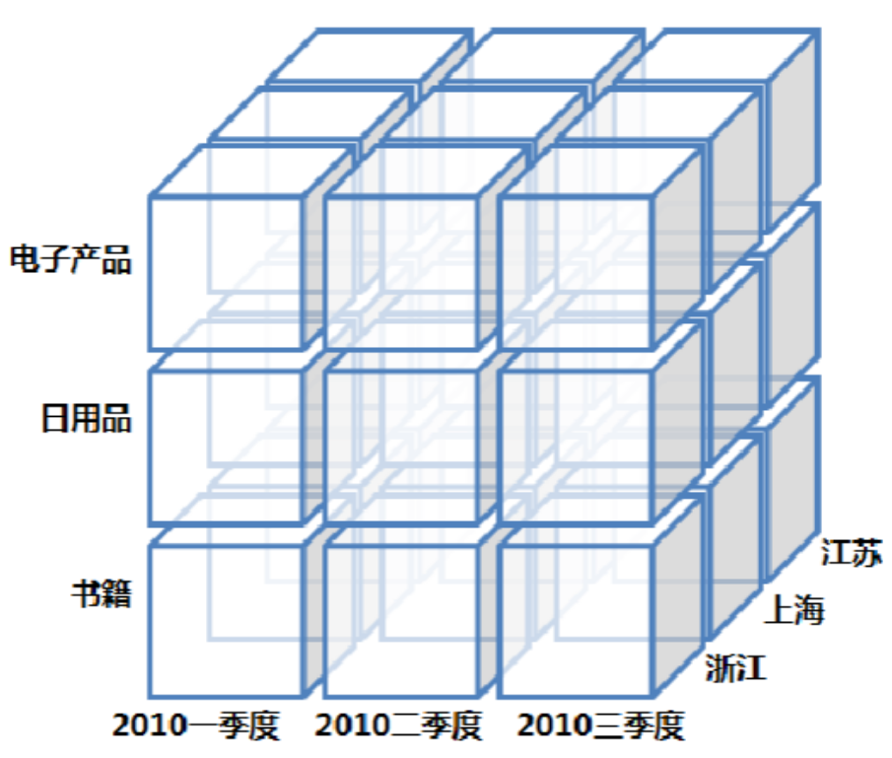
Data Warehouse — Subject-Oriented
Organized around major subjects, such as customer, product, sales.
Focusing on the modeling and analysis of data for decision makers, not on daily operations or transaction processing.
Provide a simple and concise view around particular subject issues by excluding data that are not useful in the decision support process.

Slide 4
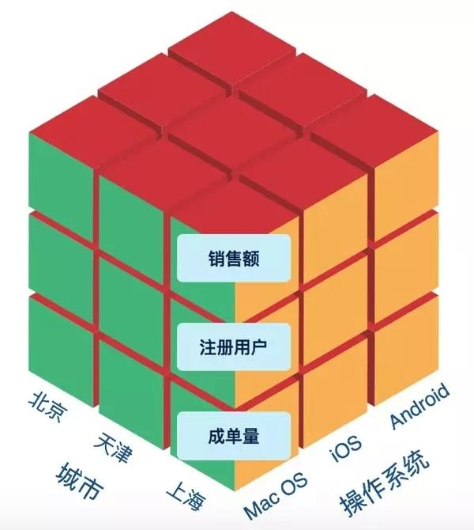
Data Warehouse — Integrated
Constructed by integrating multiple, heterogeneous data sources
relational databases, flat files, on-line transaction records
Data cleaning and data integration techniques are applied.
Ensure consistency in naming conventions, encoding structures, attribute measures, etc. among different data sources
E.g., Hotel price: currency, tax, breakfast covered, etc.
When data is moved to the warehouse, it is converted

Slide 5
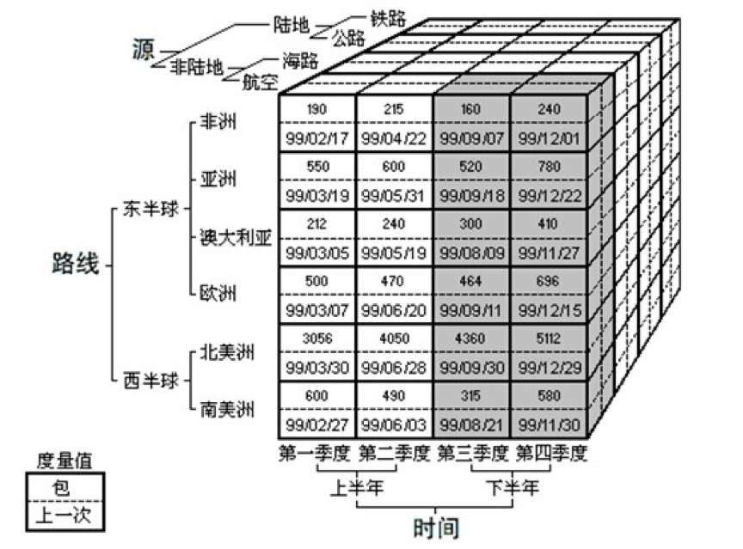
Data Warehouse—Time Variant
The time horizon for the data warehouse is significantly longer than that of operational systems.
Operational database: current value data.
Data warehouse data: provide information from a historical perspective (e.g., past 5-10 years)
Every key structure in the data warehouse
Contains an element of time, explicitly or implicitly
But the key of operational data may or may not contain “time element”.

Slide 6
Data Warehouse—Non-Volatile(非易失的)
A physically separate store of data transformed from the operational environment.
Operational update of data does not occur in the data warehouse environment.
Does not require transaction processing, recovery, and concurrency（并发） control mechanisms
Requires only two operations in data accessing:
initial loading of data and access of data.

Slide 7
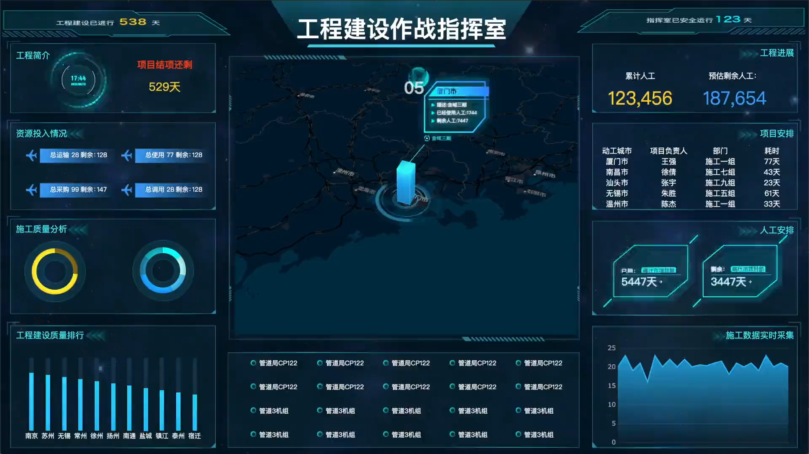
What is a data warehouse?
Data warehouse is a semantically consistent store that serves as a physical implementation of a decision support data model and stores the information on which and enterprise needs to make strategic decisions.
Data warehouse is viewed as an architecture, constructed by integrating data from multiple heterogeneous sources to support structured and/or ad hoc queries, analytical reporting, and decision making.

Slide 8
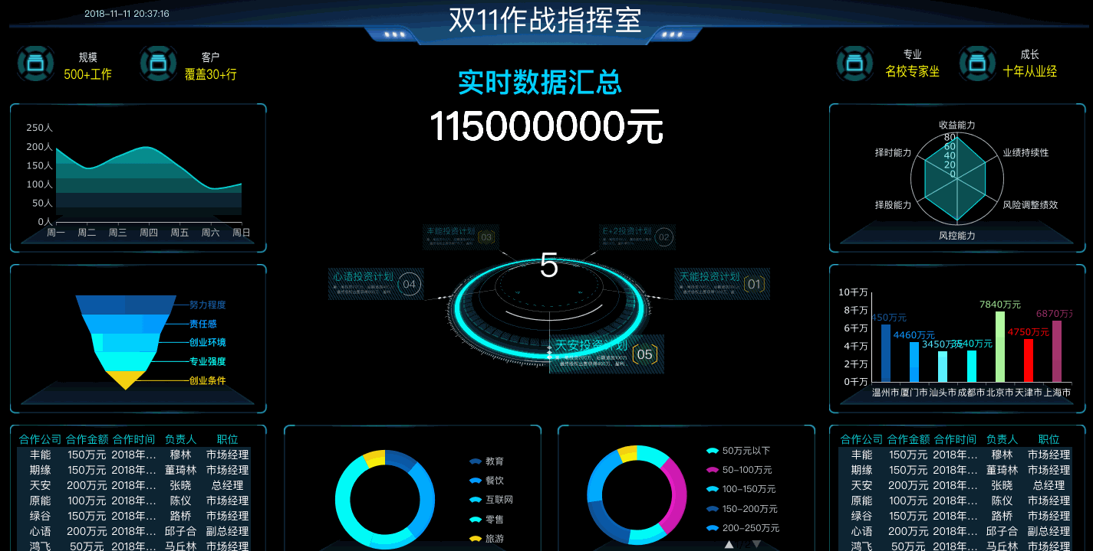
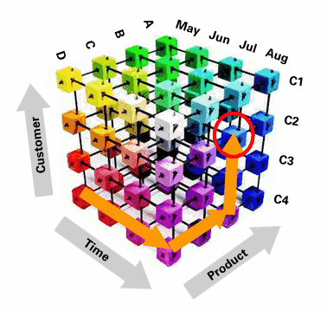
What is data warehouse used for?
Increasing customer focus
buying patterns, buying preference
Fine-tuning production strategies
repositioning(重新配置) products and managing product portfolios（组合）.
Analyzing operations and looking for sources of profit
Managing the customer relationships

Slide 9
Data Warehouse vs. Heterogeneous DBMS
Traditional heterogeneous DB integration:
Build wrappers/mediators on top of heterogeneous databases
Query driven approach
When a query is posed to a client site, a meta-dictionary is used to translate the query into queries appropriate for individual heterogeneous sites involved, and the results are integrated into a global answer set
Complex information filtering, compete for resources
Data warehouse: update-driven, high performance
Information from heterogeneous sources is integrated in advance and stored in warehouses for direct query and analysis

Slide 10
Data Warehouse vs. Operational DBMS
OLTP (On-Line Transaction Processing，联机事务处理)
Major task of traditional relational DBMS
Day-to-day operations: purchasing, inventory（库存）, banking, manufacturing, payroll(工资单), registration, accounting, etc.
OLAP (On-Line Analytical Processing，联机分析处理)
Major task of data warehouse system
Data analysis and decision making
Distinct features (OLTP vs. OLAP):
User and system orientation: customer vs. market
Data contents: current, detailed vs. historical, consolidated（合并统一）
Database design: ER + application vs. star + subject
View: current, local vs. evolutionary, integrated
Access patterns: update vs. read-only but complex queries

Slide 11
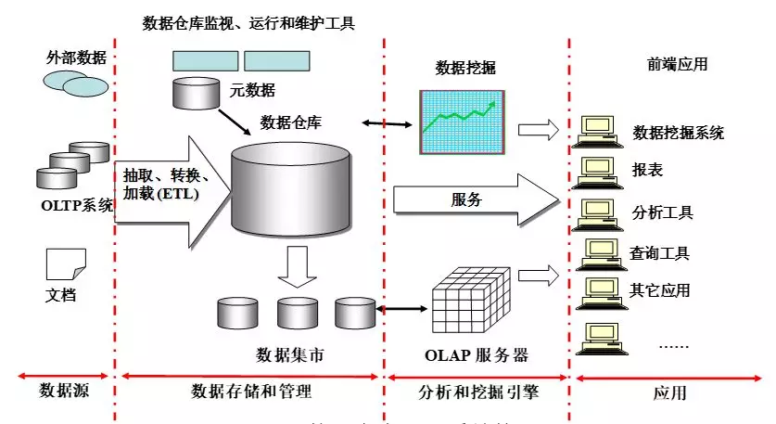
OLTP vs. OLAP

Slide 12
OLTP vs. OLAP

Slide 13
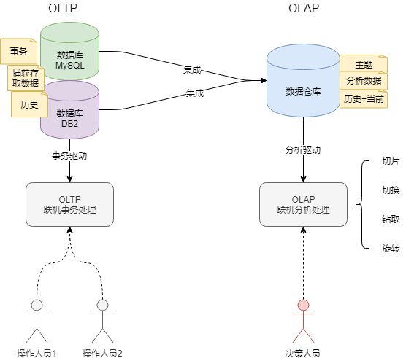
OLTP vs. OLAP

Slide 14
Why Separate Data Warehouse?
High performance for both systems
DBMS— tuned for OLTP: access methods, indexing, concurrency control, recovery
Warehouse—tuned for OLAP: complex OLAP queries, multidimensional view, consolidation
Different functions and different data:
missing data(缺失): Decision support requires historical data which operational DBs do not typically maintain
data consolidation（整合）: DS requires consolidation (aggregation, summarization) of data from heterogeneous sources
data quality（质量）: different sources typically use inconsistent data representations, codes and formats which have to be reconciled (一致化处理)
Note: There are more and more systems which perform OLAP analysis directly on relational databases

Slide 15
Thanks！
Notes:
工作新意图发现

